Slide 1

Next Gen-AI Day Trading ~ Team 3 Capstone Project
By:
Rahul Vemuri
Jashwanth Varma

Slide 2




01
Problem Statement
Outline
02
Data Collection

Slide 3

Problem Statement
Day traders need to make rapid, high-stakes decisions based on constantly changing market conditions. However, the overwhelming volume of real-time data, news, and market signals makes it difficult to process and act upon relevant information quickly.
Traditional tools and strategies often fall short in providing timely insights, forcing traders to rely on instinct and limited data, which can result in missed opportunities and increased risk.
Real-Time Data Aggregation: A system that gathers and analyzes live financial data, news, and market signals in real time, helping traders stay ahead of market trends.
AI-Driven Market Forecasts: Predictive models fine-tuned for short-term market movements, offering actionable insights and recommendations for day trades. Customizable Trading Alerts: Automated alerts based on market conditions and the trader’s personal strategies, ensuring quick action on critical market opportunities.
AI-Powered Sentiment Analysis: An engine that tracks market sentiment through real-time news and social media, helping traders understand the market’s mood and how it might influence stock prices.

Slide 4

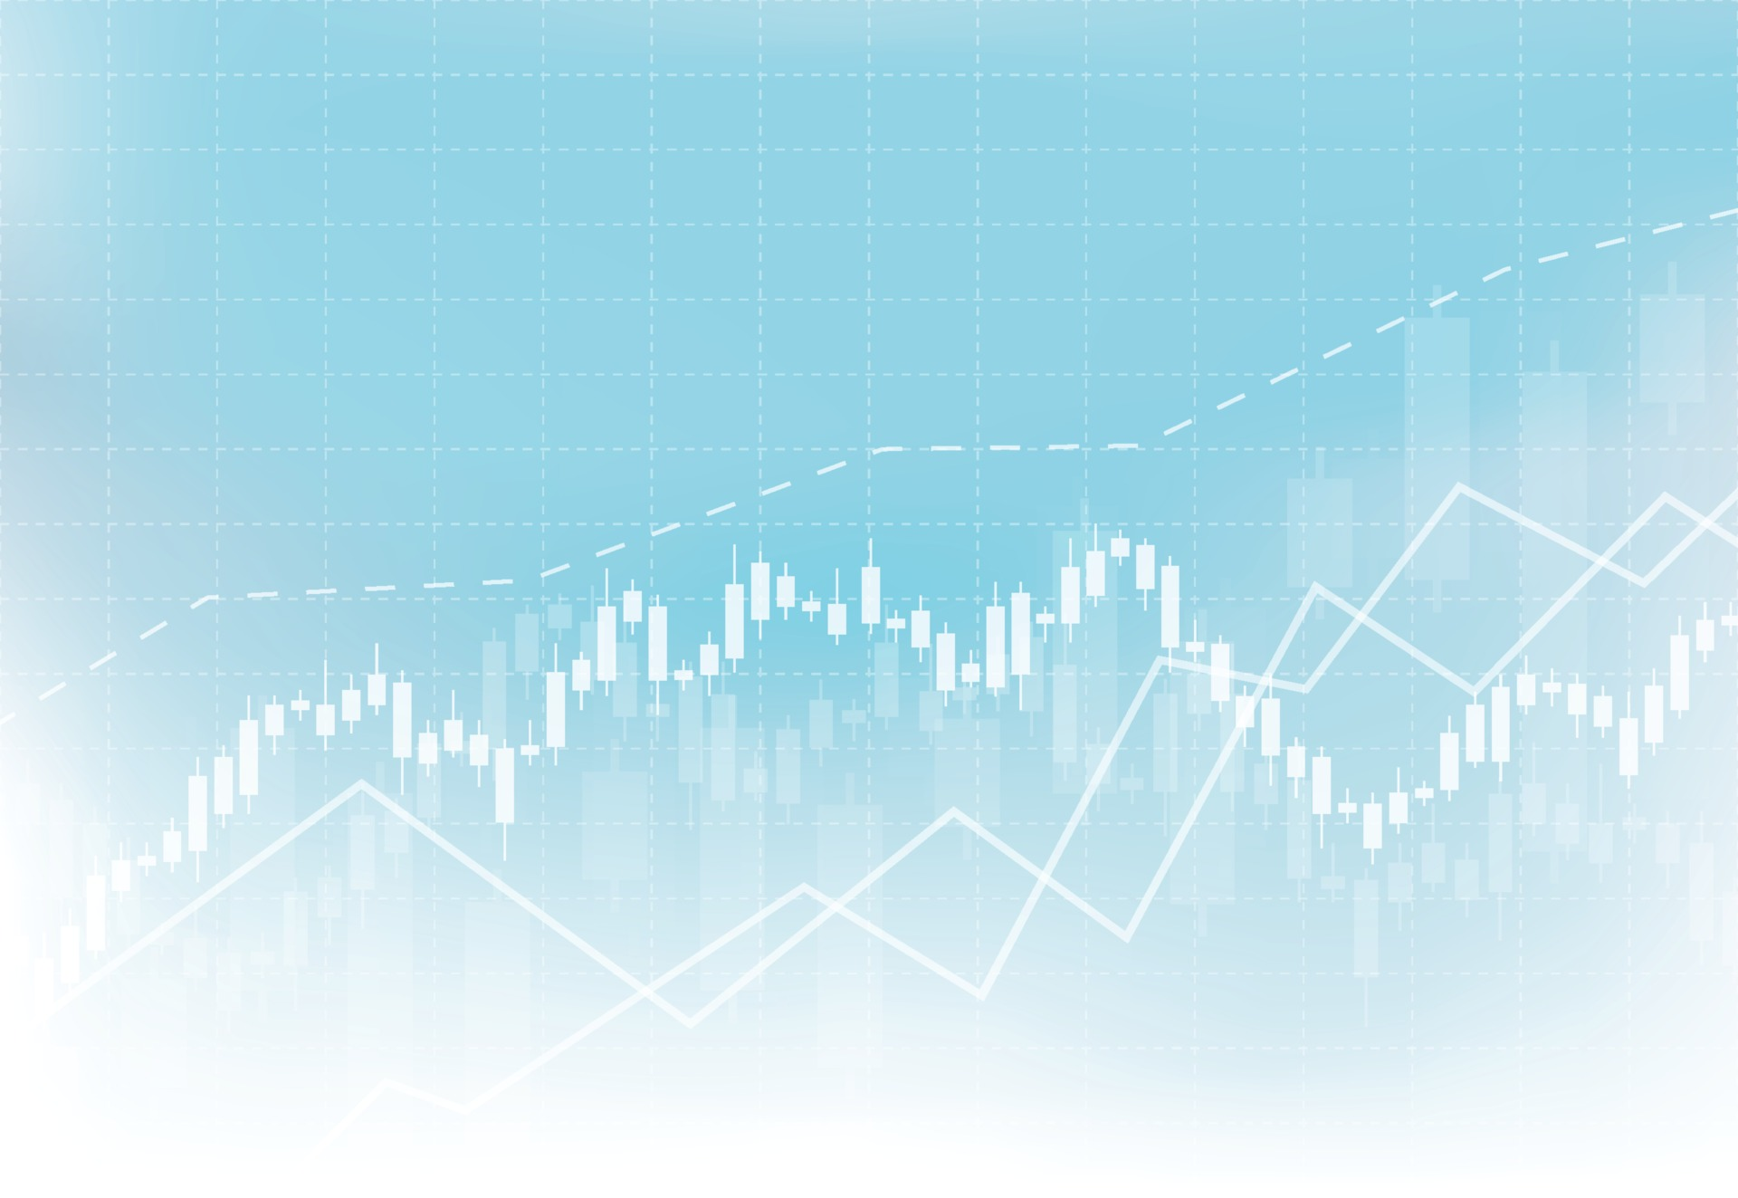
Data Cleaning
Steps
Standardizing the date format for Nbeats
Fill Missing values with the last traded price for both the train and test data to make the time series data continuous
Using darts predefined function for normalization of data
Integrating the news data with the stock prices
Creating a custom function for calculating MAPE
Detecting Outliers, skewness & bimodal distribution for erroneous events

Slide 5
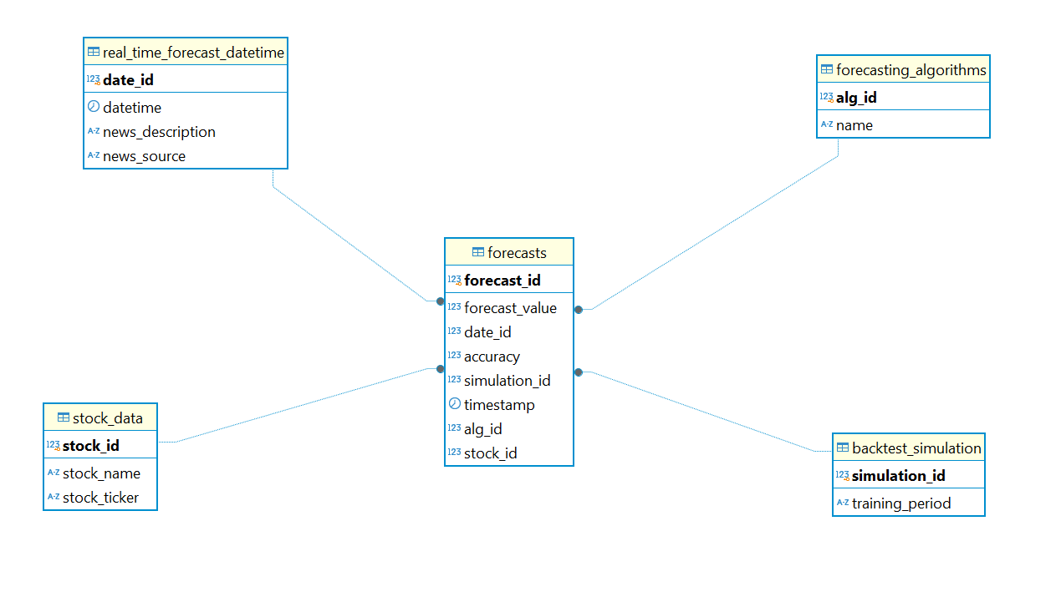
Data Warehouse Architecture

Slide 6
Thank you

Slide 7


Data Collection
Real Time Data
Get minutely historical & real-time data from yahoo finance
https://pypi.org/project/yfinance/
News Data
AI Agent to get the real-time news for a stock
Use NewsAPI.org to get historical news of the stock
News API – Search News and Blog Articles on the Web

Slide 8
Goals & Objectives
Real Time Forecasting
Forecast the stock price at Real-Time
AI Agent
To get real-time news
and perform sentiment analysis
Fine Tuned LLM
To predict the market movement for the day by
fine-tuning on sentiment & patterns
Will allow users to interact with the system to ask
complex questions about market conditions, request
predictions for specific stocks, and receive detailed
explanations behind the forecasts.
RAG chatbot

